Slide 1
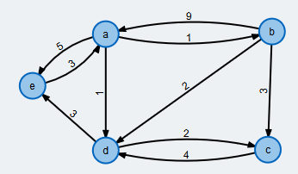
Group Name: Error 404
Group Leader: Mark Decello
Group Members: Mark Decello, Julius Lopez, Gene Olivia, Hanel Duran, Naglaa Saeid
 | a | b | c | d | e
a | 0 | 1 | 4 | 1 | 5
b | 9 | 0 | 3 | 2 | 14
c | ∞ | ∞ | 0 | 4 | ∞
d | ∞ | ∞ | 2 | 0 | 3
e | 3 | 4 | 7 | 4 | 0
 | a | b | c | d | e
a | a | b | b | d | e
b | a | b | c | d | a
c | a | b | c | d | e
d | a | b | c | d | e
e | a | a | b | a | e
Find D₀ D₁ D₂ D₃ D₄
Find S₀ S₁ S₂ S₃ S₄
Specify the shortest path between any pair of vertices
D₂ =
S_{b} =
 | a | b | c | d | e
a | 0 | 1 | 4 | 1 | 5
b | 9 | 0 | 3 | 2 | 14
c | ∞ | ∞ | 0 | 4 | ∞
d | ∞ | ∞ | 2 | 0 | 3
e | 3 | 4 | 7 | 4 | 0
 | a | b | c | d | e
a | a | b | b | d | e
b | a | b | c | d | a
c | a | b | c | d | e
d | a | b | c | d | e
e | a | a | b | a | e
D₃ =
S_{c} =
4
 | a | b | c | d | e
a | 0 | 1 | ∞ | 1 | 5
b | 9 | 0 | 3 | 2 | ∞
c | ∞ | ∞ | 0 | 4 | ∞
d | ∞ | ∞ | 2 | 0 | 3
e | 3 | ∞ | ∞ | ∞ | 0
 | a | b | c | d | e
a | a | b | c | d | e
b | a | b | c | d | e
c | a | b | c | d | e
d | a | b | c | d | e
e | a | b | c | d | e
 | a | b | c | d | e
a | 0 | 1 | 3 | 1 | 4
b | 9 | 0 | 3 | 2 | 5
c | ∞ | ∞ | 0 | 4 | 7
d | ∞ | ∞ | 2 | 0 | 3
e | 3 | 4 | 6 | 4 | 0
 | a | b | c | d | e
a | a | b | d | d | d
b | a | b | c | d | d
c | a | b | c | d | d
d | a | b | c | d | e
e | a | a | d | a | e
D₀ =
S₀ =
D₄ =
S_{d} =
 | a | b | c | d | e
a | 0 | 1 | ∞ | 1 | 5
b | 9 | 0 | 3 | 2 | 14
c | ∞ | ∞ | 0 | 4 | ∞
d | ∞ | ∞ | 2 | 0 | 3
e | 3 | 4 | ∞ | 4 | 0
 | a | b | c | d | e
a | a | b | c | d | e
b | a | b | c | d | a
c | a | b | c | d | e
d | a | b | c | d | e
e | a | a | c | a | e
 | a | b | c | d | e
a | 0 | 1 | 3 | 1 | 4
b | 8 | 0 | 3 | 2 | 5
c | 10 | 11 | 0 | 4 | 7
d | 6 | 7 | 2 | 0 | 3
e | 3 | 4 | 6 | 4 | 0
 | a | b | c | d | e
a | a | b | d | d | d
b | e | b | c | d | d
c | e | e | c | d | d
d | e | e | c | d | e
e | a | a | d | a | e
D₁ =
S_{a} =
D₅ =
S_{e} =

Slide 2
Source Vertex | Destination Vertex | Distance | Shortest Path
a | b | 1 | a->b
a | c | 3 | a->d->c
a | d | 1 | a->d
a | e | 4 | a->d->e
b | a | 8 | b->e->a
b | c | 3 | b->c
b | d | 2 | b->d
b | e | 5 | b>d->e
c | a | 10 | c->e->a
c | b | 11 | c->e->b
c | d | 4 | c->d
c | e | 7 | c->d->e
d | a | 6 | d->e->a
d | b | 7 | d->e->b
d | c | 2 | d->c
d | e | 3 | d->e
e | a | 3 | e->a
e | b | 4 | e->a->b
e | c | 6 | e->d->c
e | d | 4 | e->a->d
 | a | b | c | d | e
a | 0 | 1 | 3 | 1 | 4
b | 8 | 0 | 3 | 2 | 5
c | 10 | 11 | 0 | 4 | 7
d | 6 | 7 | 2 | 0 | 3
e | 3 | 4 | 6 | 4 | 0
D₅ =
 | a | b | c | d | e
a | a | b | d | d | d
b | e | b | c | d | d
c | e | e | c | d | d
d | e | e | c | d | e
e | a | a | d | a | e
S_{e} =

Slide 3
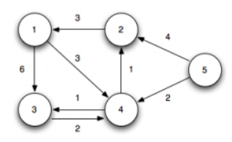
Exercise A
 | 1 | 2 | 3 | 4 | 5
1 | 0 | ∞ | 6 | 3 | ∞
2 | 3 | 0 | 9 | 6 | ∞
3 | ∞ | ∞ | 0 | 2 | ∞
4 | 4 | 1 | 1 | 0 | ∞
5 | 7 | 4 | 13 | 2 | 0
 | 1 | 2 | 3 | 4 | 5
1 | 1 | 2 | 3 | 4 | 5
2 | 1 | 2 | 1 | 1 | 5
3 | 1 | 2 | 3 | 4 | 5
4 | 2 | 2 | 3 | 4 | 5
5 | 2 | 2 | 2 | 4 | 5
D₂ =
S₂ =
 | 1 | 2 | 3 | 4 | 5
1 | 0 | ∞ | 6 | 3 | ∞
2 | 3 | 0 | 9 | 6 | ∞
3 | ∞ | ∞ | 0 | 2 | ∞
4 | 4 | 1 | 1 | 0 | ∞
5 | 7 | 4 | 13 | 2 | 0
 | 1 | 2 | 3 | 4 | 5
1 | 1 | 2 | 3 | 4 | 5
2 | 1 | 2 | 1 | 1 | 5
3 | 1 | 2 | 3 | 4 | 5
4 | 2 | 2 | 3 | 4 | 5
5 | 2 | 2 | 2 | 4 | 5
 | 1 | 2 | 3 | 4 | 5
1 | 0 | ∞ | 6 | 3 | ∞
2 | 3 | 0 | ∞ | ∞ | ∞
3 | ∞ | ∞ | 0 | 2 | ∞
4 | ∞ | 1 | 1 | 0 | ∞
5 | ∞ | 4 | ∞ | 2 | 0
 | 1 | 2 | 3 | 4 | 5
1 | 1 | 2 | 3 | 4 | 5
2 | 1 | 2 | 3 | 4 | 5
3 | 1 | 2 | 3 | 4 | 5
4 | 1 | 2 | 3 | 4 | 5
5 | 1 | 2 | 3 | 4 | 5
D₃ =
S₃ =
D₀ =
S₀ =
 | 1 | 2 | 3 | 4 | 5
1 | 0 | 4 | 4 | 3 | ∞
2 | 3 | 0 | 7 | 6 | ∞
3 | 6 | 3 | 0 | 2 | ∞
4 | 4 | 1 | 1 | 0 | ∞
5 | 6 | 3 | 3 | 2 | 0
 | 1 | 2 | 3 | 4 | 5
1 | 1 | 4 | 4 | 4 | 5
2 | 1 | 2 | 4 | 1 | 5
3 | 4 | 4 | 3 | 4 | 5
4 | 2 | 2 | 3 | 4 | 5
5 | 4 | 4 | 4 | 4 | 5
 | 1 | 2 | 3 | 4 | 5
1 | 0 | ∞ | 6 | 3 | ∞
2 | 3 | 0 | 9 | 6 | ∞
3 | ∞ | ∞ | 0 | 2 | ∞
4 | ∞ | 1 | 1 | 0 | ∞
5 | ∞ | 4 | ∞ | 2 | 0
 | 1 | 2 | 3 | 4 | 5
1 | 1 | 2 | 3 | 4 | 5
2 | 1 | 2 | 1 | 1 | 5
3 | 1 | 2 | 3 | 4 | 5
4 | 1 | 2 | 3 | 4 | 5
5 | 1 | 2 | 3 | 4 | 5
D₄ =
S₄ =
D₁ =
S₁ =
 | 1 | 2 | 3 | 4 | 5
1 | 0 | 4 | 4 | 3 | ∞
2 | 3 | 0 | 7 | 6 | ∞
3 | 6 | 3 | 0 | 2 | ∞
4 | 4 | 1 | 1 | 0 | ∞
5 | 6 | 3 | 3 | 2 | 0
 | 1 | 2 | 3 | 4 | 5
1 | 1 | 4 | 4 | 4 | 5
2 | 1 | 2 | 4 | 1 | 5
3 | 4 | 4 | 3 | 4 | 5
4 | 2 | 2 | 3 | 4 | 5
5 | 4 | 4 | 4 | 4 | 5
D₅ =
S₅ =

Slide 4
Source Vertex | Destination Vertex | Distance | Shortest Path
1 | 2 | 4 | 1->4->2
1 | 3 | 4 | 1->4->3
1 | 4 | 3 | 1->4
1 | 5 | ∞ | null
2 | 1 | 3 | 2->1
2 | 3 | 7 | 2->4->3
2 | 4 | 6 | 2->1->4
2 | 5 | ∞ | null
3 | 1 | 6 | 3->4->1
3 | 2 | 3 | 3->4->2
3 | 4 | 2 | 3->4
3 | 5 | ∞ | null
4 | 1 | 4 | 4->2->1
4 | 2 | 1 | 4->2
4 | 3 | 1 | 4->3
4 | 5 | ∞ | null
5 | 1 | 6 | 5->4->2->1
5 | 2 | 3 | 5->4->2
5 | 3 | 3 | 5->4->3
5 | 4 | 2 | 5-4
 | 1 | 2 | 3 | 4 | 5
1 | 0 | 4 | 4 | 3 | ∞
2 | 3 | 0 | 7 | 6 | ∞
3 | 6 | 3 | 0 | 2 | ∞
4 | 4 | 1 | 1 | 0 | ∞
5 | 6 | 3 | 3 | 2 | 0
D₅ =
 | 1 | 2 | 3 | 4 | 5
1 | 1 | 4 | 4 | 4 | 5
2 | 1 | 2 | 4 | 1 | 5
3 | 4 | 4 | 3 | 4 | 5
4 | 2 | 2 | 3 | 4 | 5
5 | 4 | 4 | 4 | 4 | 5
S₅ =

Slide 5
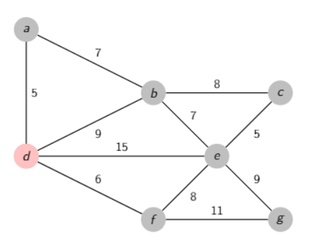
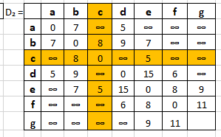
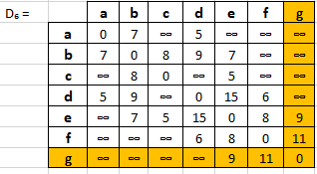
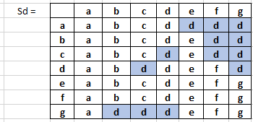
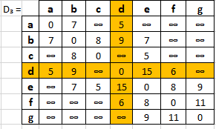
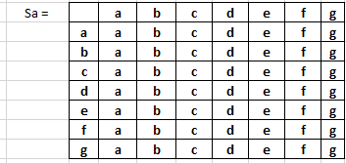
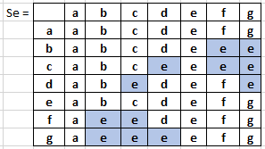
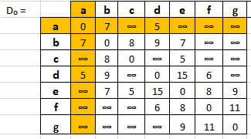
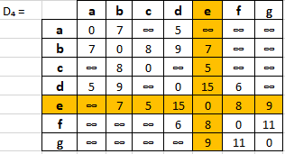
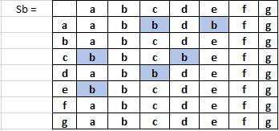
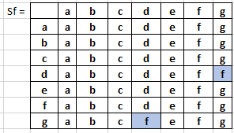
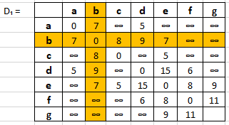
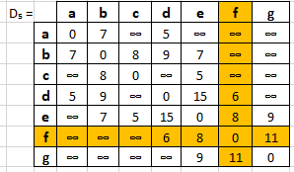
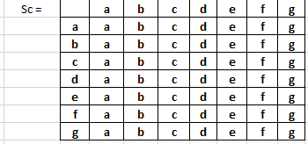
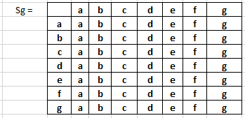
Exercise B

Slide 6
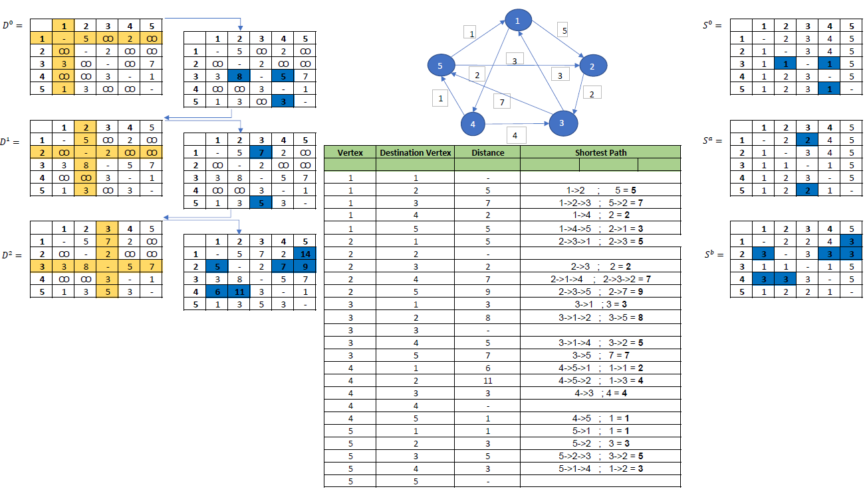
Exercise C

Slide 7
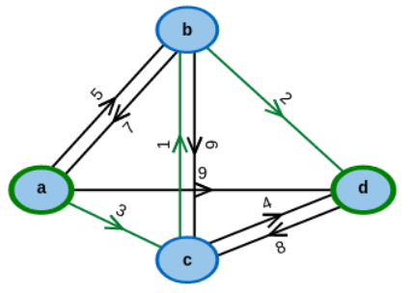
Exercise D
 | a | b | c | d
a | 0 | 5 | 3 | 9
b | 7 | 0 | 9 | 2
c | ∞ | 1 | 0 | 4
d | ∞ | ∞ | 8 | 0
 | a | b | c | d
a | a | b | c | d
b | a | b | c | d
c | a | b | c | d
d | a | b | c | d
D₁ =
S_{a} =
 | a | b | c | d
a | 0 | 5 | 3 | 7
b | 7 | 0 | 9 | 2
c | 8 | 1 | 0 | 3
d | ∞ | ∞ | 8 | 0
 | a | b | c | d
a | a | b | c | b
b | a | b | c | d
c | b | b | c | b
d | a | b | c | d
D₂ =
S_{b} =
 | a | b | c | d
a | 0 | 5 | 3 | 9
b | 7 | 0 | 9 | 2
c | ∞ | 1 | 0 | 4
d | ∞ | ∞ | 8 | 0
 | a | b | c | d
a | a | b | c | d
b | a | b | c | d
c | a | b | c | d
d | a | b | c | d
 | a | b | c | d
a | 0 | 4 | 3 | 6
b | 7 | 0 | 9 | 2
c | 8 | 1 | 0 | 3
d | 16 | 9 | 8 | 0
 | a | b | c | d
a | a | c | c | c
b | a | b | c | d
c | b | b | c | b
d | c | c | c | d
D₀ =
S₀ =
D₃ =
S_{c} =
 | a | b | c | d
a | 0 | 4 | 3 | 6
b | 7 | 0 | 9 | 2
c | 8 | 1 | 0 | 3
d | 16 | 9 | 8 | 0
 | a | b | c | d
a | a | c | c | c
b | a | b | c | d
c | b | b | c | b
d | c | c | c | d
D₄ =
S_{d} =

Slide 8
Source Vertex | Destination Vertex | Distance | Shortest Path
a | b | 4 | a->c->b
a | c | 3 | a->c
a | d | 6 | a->c->d
b | a | 7 | b->a
b | c | 9 | b->c
b | d | 2 | b->d
c | a | 8 | c->b->a
c | b | 1 | c->b
c | d | 3 | c->b->d
d | a | 16 | d->c->b->a
d | b | 9 | d->c->b
d | c | 8 | d->c
 | a | b | c | d
a | 0 | 4 | 3 | 6
b | 7 | 0 | 9 | 2
c | 8 | 1 | 0 | 3
d | 16 | 9 | 8 | 0
D₄ =
S_{d} =
 | a | b | c | d
a | a | c | c | c
b | a | b | c | d
c | b | b | c | b
d | c | c | c | d

Slide 9
